Slide 1
What is Energy?

Slide 2
By the end of this lesson you should be able to do the following:
1. | Define energy.
2. | Name the two types of energy.

Slide 3
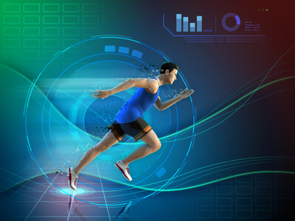

Energy is a word we use to describe how active we feel.
A runner may say they have a lot of energy, while a student may say they have very little energy!
We eat and sleep to regain energy, and we use it up playing sport and doing housework.

Slide 4
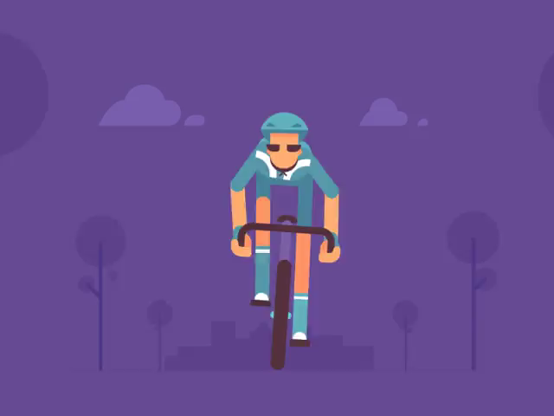
Energy is the ability of an object to do work.
If an object is doing work, it is making something happen. Walking, running, cycling and swimming are all types of work because you use energy to do them.

Slide 5
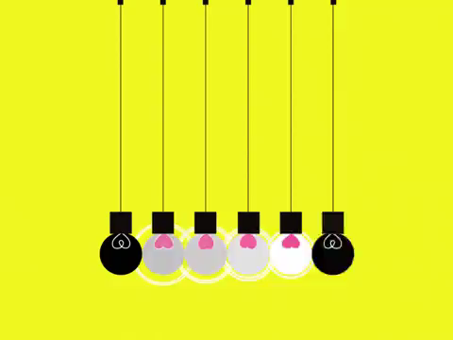
Lightbulbs use energy to make light and cars use energy to drive.
Energy is made available to use by the food you eat, or by the power plugs on your wall.
Energy is everywhere, and constantly being used by everything. How can there be so much energy in the world?

Slide 6
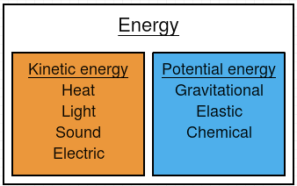
Energy can be split into two different types: kinetic energy and potential energy.
Kinetic energy is energy used by movement. Potential energy is energy that is stored in objects.

